Slide 1

Social Media fake Profile Detection system
M.Sc. Cyber Security – Semester-04
School of Cyber Security and Digital Forensics
NFSU, Gandhinagar
April, 2026
Presented By,
Tanmay V. Buranpuri
240103002038
Supervised By,
Dr. Ashutosh Tripathi
Assistant Professor

Slide 2
Outline
Introduction
Problem Definition & Motivation
Aim & Objectives
Literature Survey
Proposed System
Implementation Setup
Overall System Archetecture Diagram
System Working (Web Dasboard)
Results & Analysis
Conclusion & Future Work
References

Slide 3

Introduction
The system uses artificial intelligence to identify fake accounts which impersonate users on social media platforms.
The system mainly operates through automatic data gathering to inspect Instagram user profiles.
The system identifies suspicious accounts through matching their profiles with their online behavior and through examining their profile pictures.
The system operates through a complete design which includes a React web dashboard and a Flask backend API.
The system executes scans as background tasks which provide users with a scan ID to monitor their scan status.
The system maintains a record of all scanning activities together with their outcomes which it stores in MongoDB to enable future examination.
The system produces two outputs which consist of a direct risk assessment and an explanation of why the account generated suspicions.

Slide 4
Problem Definition & Motivation
Social media impersonation is a growing problem where attackers create fake profiles that closely resemble real users. These fake accounts are often used for scams, spreading misinformation, phishing, or damaging reputations.
Detecting such accounts manually is difficult because fake profiles often copy:
Username patterns
Profile pictures
Bio descriptions
Display names
There is a need for an automated system that can scan social platforms, compare profile attributes intelligently, and detect impersonation attempts quickly and reliably. FakeShield is motivated by this need to provide an automated impersonation detection solution.

Slide 5
Problem Definition & Motivation
Goal of FakeShield:
To build an AI-assisted system that detects potential impersonation accounts on social media (focused on Instagram)
To compare a target (original) profile with scraped candidate profiles to identify suspicious similarity patterns
To combine multiple signals—username, bio, display name, behavior, and profile photo—into one risk decision
To generate a clear risk score and confidence level that a normal user can understand
To provide a full-stack workflow: start scan → track progress → view results → store history for later review
To support asynchronous scanning so the user does not have to wait while scraping and analysis run in the background

Slide 6
Problem Definition & Motivation
Example:
A small business brand has an official Instagram page to promote products. A fake account is created using a similar name and logo to sell duplicate or fraudulent products.
How Fake Shield Help:
FakeShield can scan the official account and detect fake profiles by:
Comparing brand name similarity
Matching logo/profile image
Checking copied bio/description
Identifying abnormal behavior patterns
This helps the business quickly identify and report impersonators.

Slide 7
Aim & Objective
Aim: To design and develop a web-based system that automatically detects suspicious and impersonating social media accounts using similarity analysis and behavioral signals.
Objectives:
To collect candidate profile data using automated scraping.
To compare usernames, bios, display names, and profile photos.
To analyze behavioral indicators such as follower-to-following ratio and account age.
To generate a risk score, confidence level, and readable reasons for detection.
To provide a web dashboard where users can start scans and view results.
To maintain scan history for future reference.

Slide 8
Literature Survey
Paper Citation | Method | Technique | Limitations | Results
[1] Fake profile detection on Facebook using supervised & unsupervised learning | Detecting fake accounts by analyzing profile attributes and activity patterns | Combination of supervised classifiers and unsupervised clustering | Feature selection and attribute grouping were not highly effective | Supervised models showed better accuracy than unsupervised approaches
[2] Detection of fake Instagram accounts using dataset comparison | Comparing real and fake accounts using classification models | Bagging-based decision tree, SVM, and Naive Bayes | Accuracy decreases when dataset size increases without proper feature tuning | Bagged decision tree produced more accurate results than other algorithms
[3] Username similarity detection in social networks | Identifying impersonation through name pattern matching | Fuzzy string matching and cosine similarity | Only text-based analysis; ignores behavior and images | Effective for detecting username copying but limited overall detection
[4] Behavioral analysis for detecting fake accounts | Identifying abnormal user behavior patterns | Follower/following ratio, account age, activity frequency | Cannot detect impersonation when behavior looks normal | Behavioral signals improve detection when combined with profile analysis

Slide 9
Proposed System
The proposed system follows an automated scan pipeline:
User enters a username or profile URL in the dashboard.Frontend sends a request to the backend API to start the scan.
Backend creates a scan record and starts an asynchronous background job.
Apify is used to scrape candidate Instagram profiles.Detection modules analyze similarities in:
Username
Bio
Display name
Behavior
Profile photo
A final risk score and result are generated and stored.The frontend polls the backend and displays the results when ready.

Slide 10
Implementation setup
Frontend Technologies:
React for building the interactive web dashboard (Home, Scan, Results, History pages)
Axios for sending API requests and polling scan status
HTML, CSS, and JavaScript for user interface design
Backend Technologies:
Flask for creating REST API endpoints and managing scan workflows
Python for implementing detection logic and background processing
CORS and environment configuration for API communication

Slide 11
Implementation setup
Machine Learning / Detection Modules:
SentenceTransformers for bio similarity using text embeddings
fuzzywuzzy for username similarity detection
DeepFace for profile photo comparison
Rule-based behavioral analysis for follower ratio and account age checks
Dataset Used
Dynamic, real-time dataset generated during each scan
Data scraped from public Instagram profiles using Apify
Includes username, display name, bio, follower/following counts, account age, posts, and profile photo
Stored in MongoDB as part of scan history and result records

Slide 12
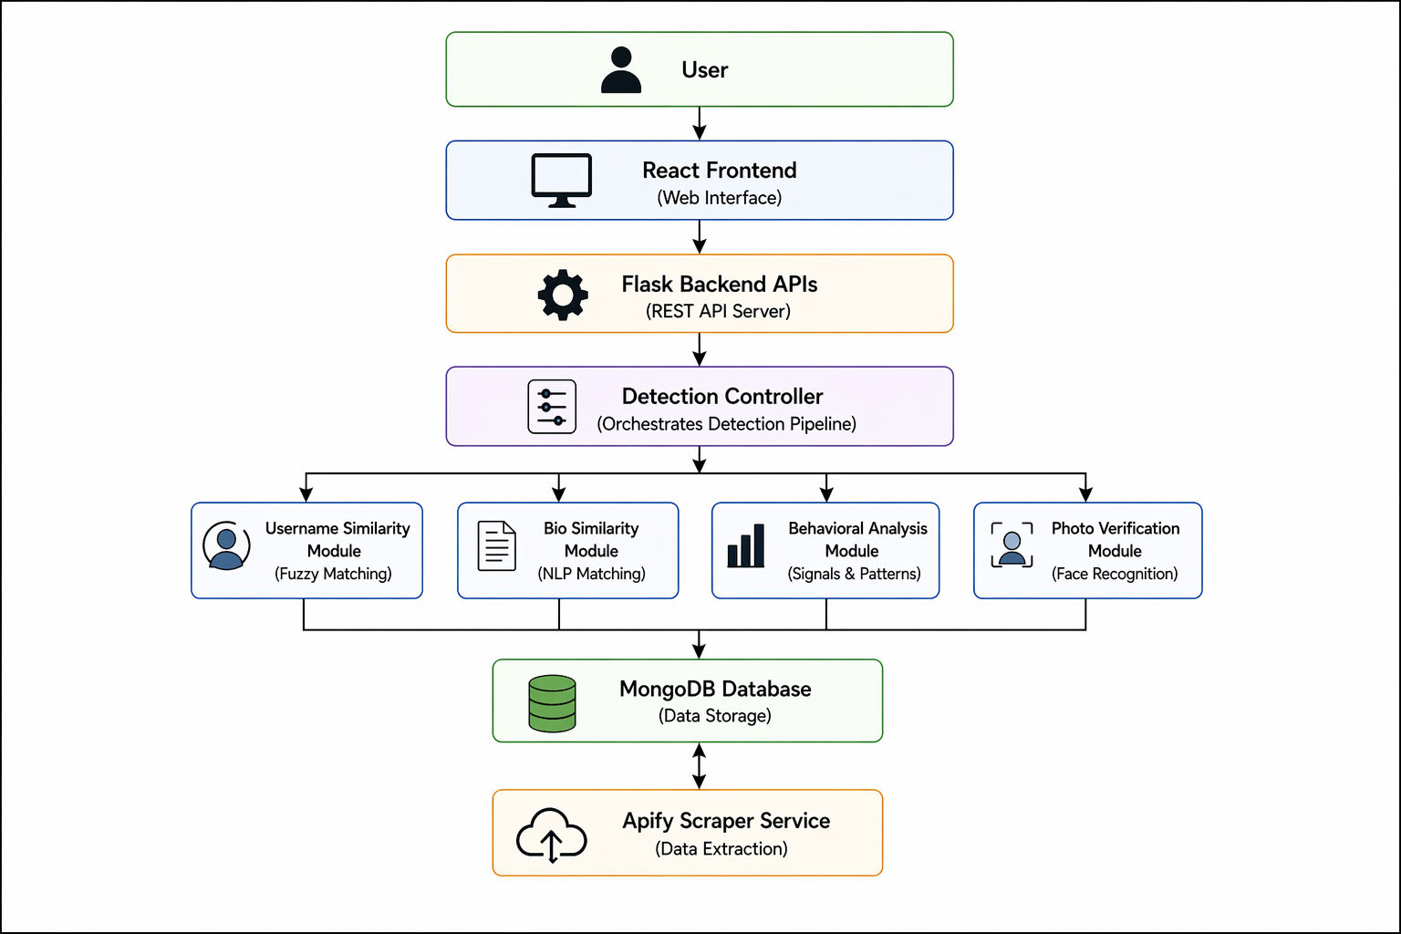
Overall System Archetecture Diagram

Slide 13
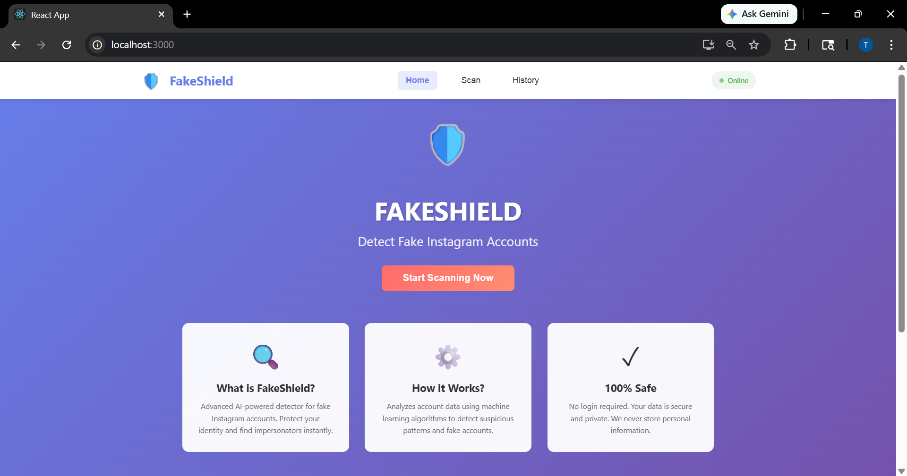
System Working Web Dash Board:
HOME PAGE

Slide 14
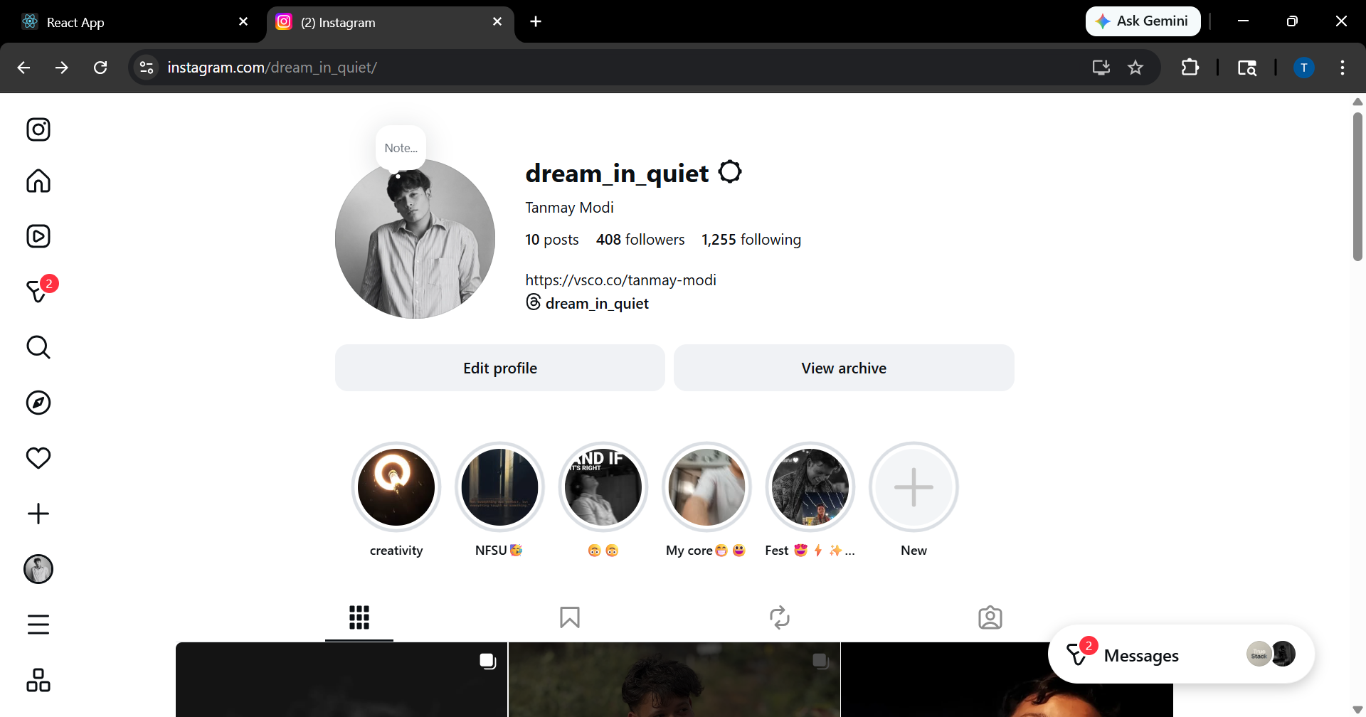
System Working Web Dash Board:
REAL INSTAGRAM PROFILE

Slide 15
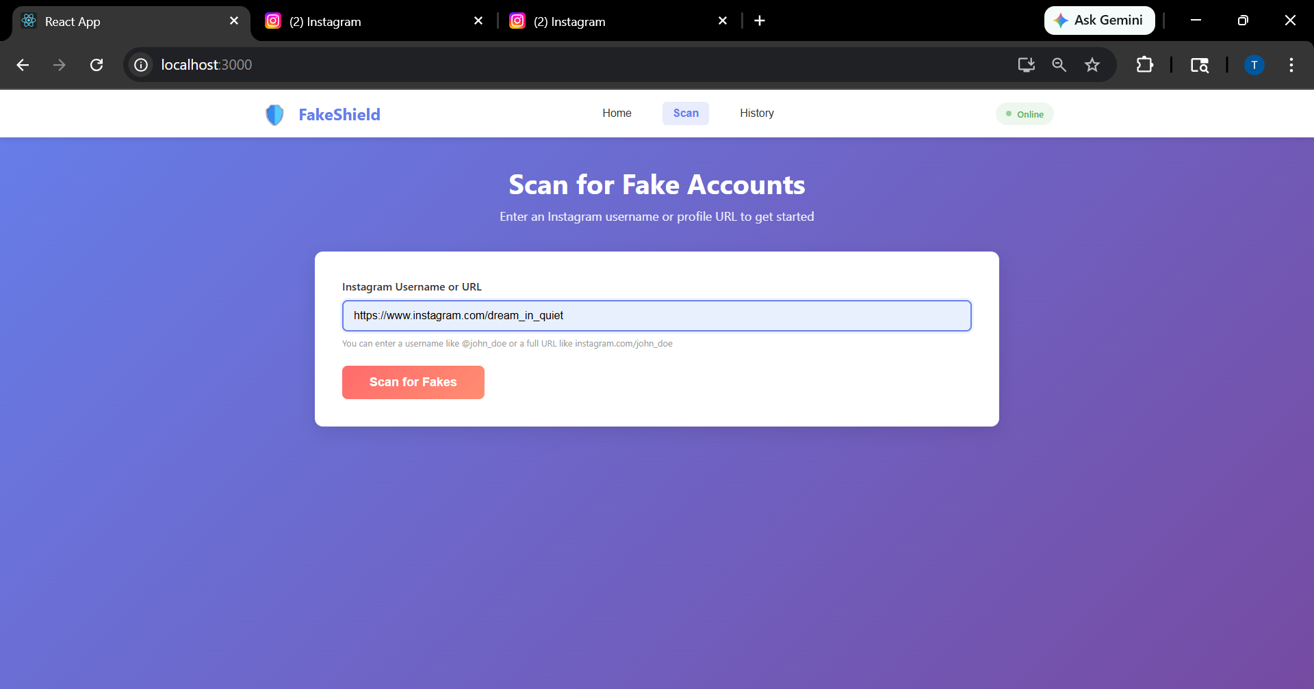
System Working Web Dash Board:
SCANNING PANNEL

Slide 16
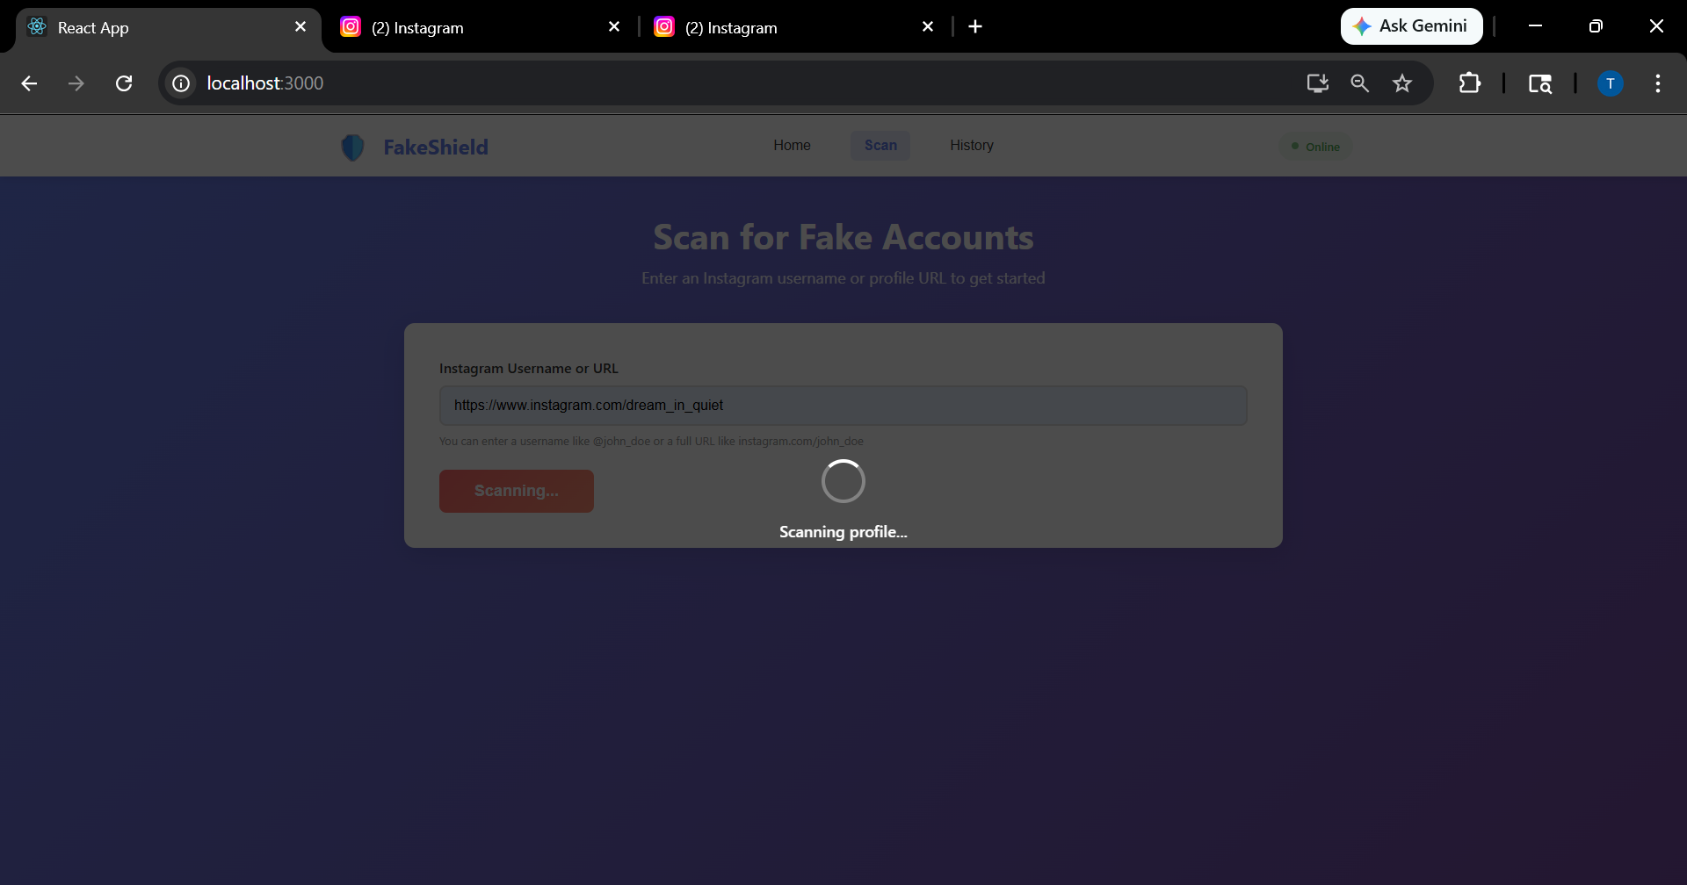
System Working Web Dash Board:
SCANNING PROCESS

Slide 17
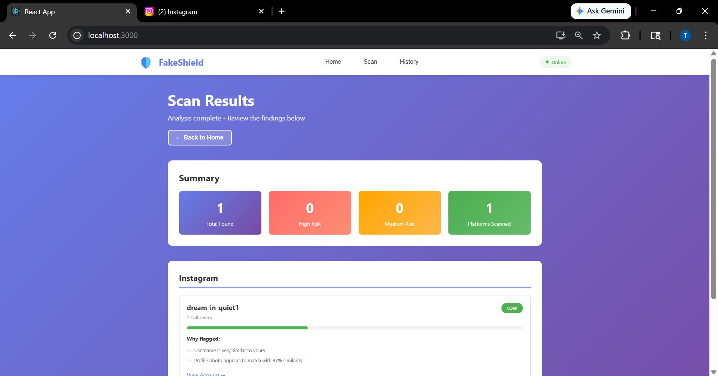
System Working Web Dash Board:
SCAN RESULT

Slide 18
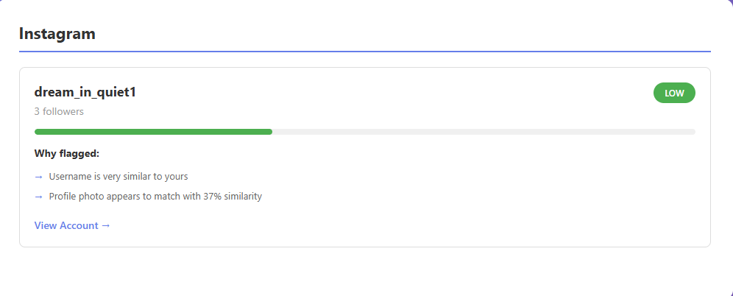
System Working Web Dash Board:
DETACTED FAKE INSTAGRAM PROFILE

Slide 19
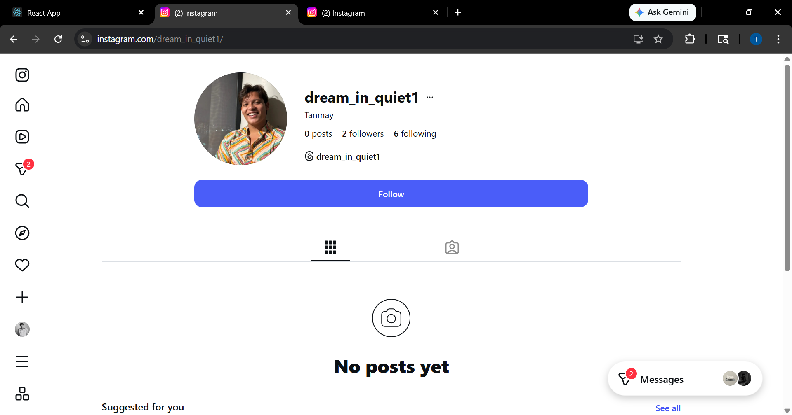
System Working Web Dash Board:
REAL PROFILE
DETACTED FAKE PROFILE

Slide 20
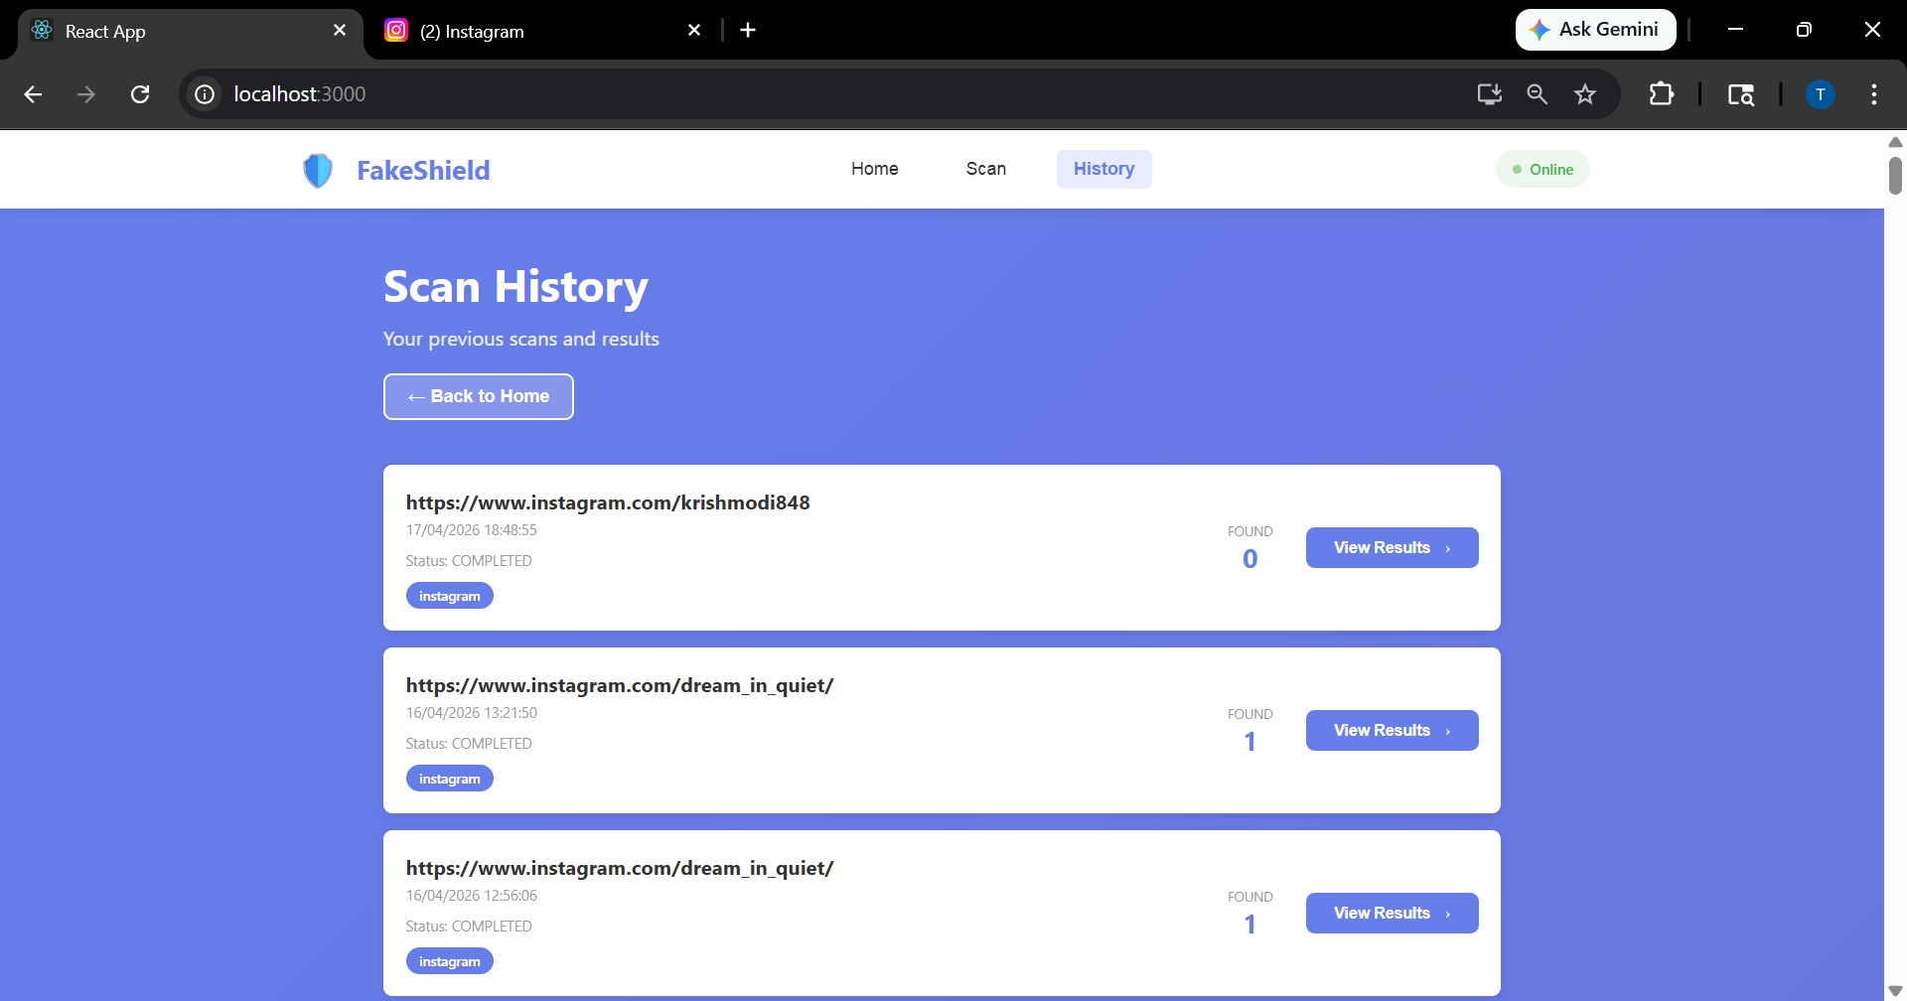
System Working Web Dash Board:
HISTORY OF SCANNED PROFILE

Slide 21
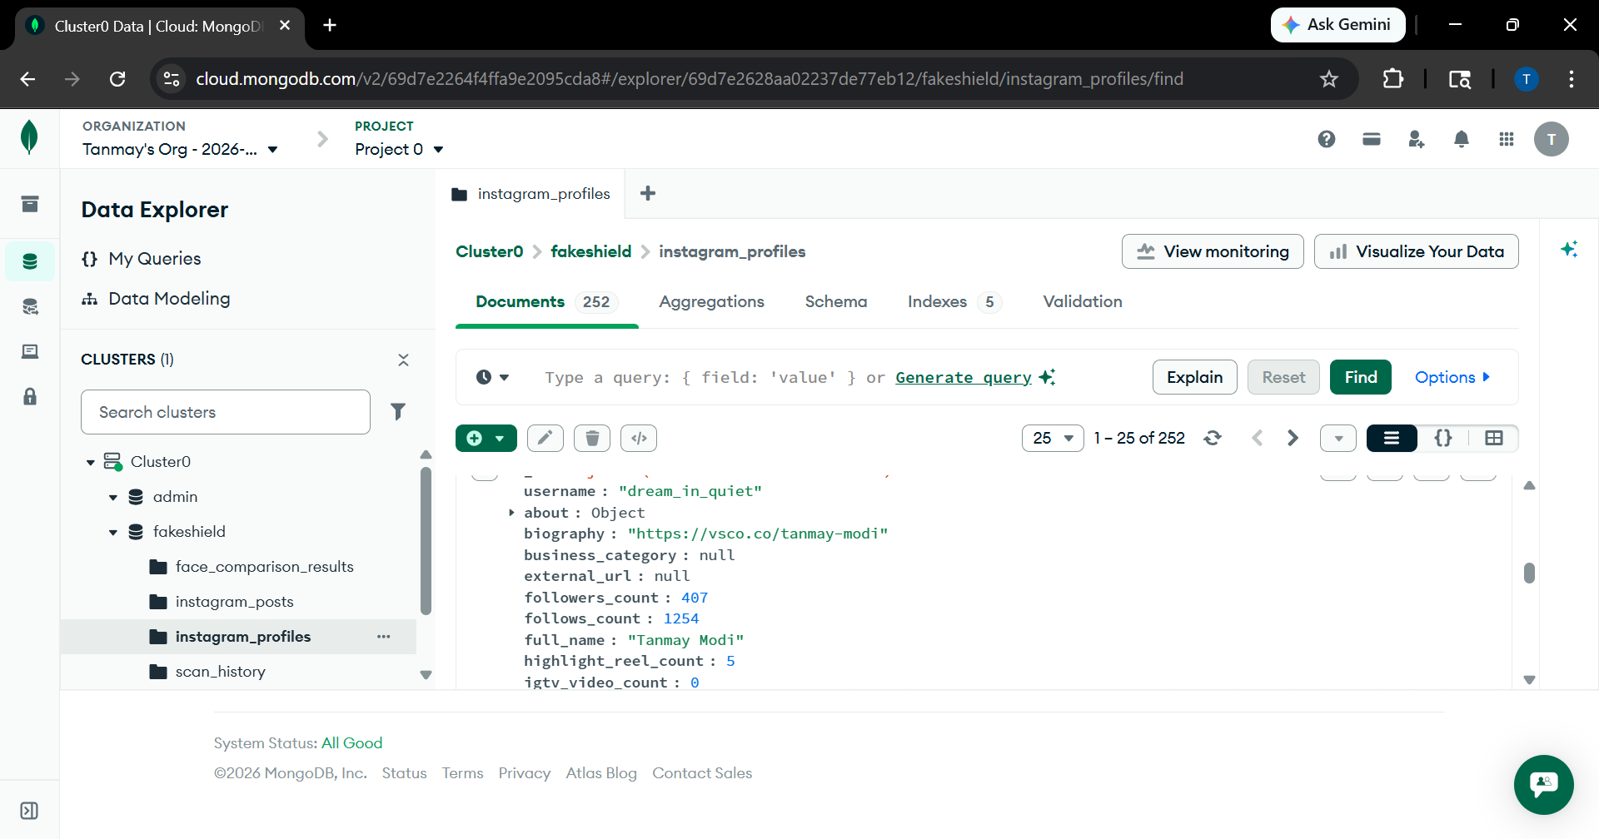
System Working Web Dash Board:
DATABASE

Slide 22
Conclusion and Future Work
FakeShield successfully demonstrates how impersonation detection can be automated using similarity analysis, behavioral signals, and photo verification.
Future improvements:
Better progress tracking in UI
Support for more social platforms
Improved test coverage
Advanced filtering and pagination in history
Clear separation of platform-specific logic

Slide 23
References
[1] Flask, "Flask Documentation," Pallets Projects. [Online]. Accessible at: https://flask.palletsprojects.com/. Last accessed: Apr. 23, 2026.
[2] React, "React Documentation," Meta. [Online]. Accessible at: https://react.dev/. Last accessed: Apr. 23, 2026.
[3] MongoDB, "MongoDB Documentation," MongoDB, Inc. [Online]. Accessible at: https://www.mongodb.com/docs/. Last accessed: Apr. 23, 2026.
[4] Apify, "Apify Documentation," Apify Technologies s.r.o. [Online]. Accessible at: https://docs.apify.com/. Last accessed: Apr. 23, 2026.
[5] Sentence-Transformers, "Sentence-Transformers Documentation," UKPLab. [Online]. Accessible at: https://www.sbert.net/. Last accessed: Apr. 23, 2026.

Slide 24


Thank You

